Slide 1


Wind Power Generation Forecasting

Slide 2

Learning Objectives
Understand the impact of wind forecasting in renewable energy management.
Learn how to preprocess wind-related datasets.
Implement regression models to predict wind power generation.
Evaluate and improve model performance.
Explore real-time forecasting potential in the energy sector.
GOAL
Source :
www.freepik.com/

Slide 3
Tools and Technology used
Python
Jupyter Notebook
Pandas, NumPy, Matplotlib, Seaborn
Scikit-learn, XGBoost
CSV Dataset (Kaggle) :- https://www.kaggle.com/datasets/mubashirrahim/wind-power-generation-data-forecasting?select=Location2.csv
Regression Modeling

Slide 4
Methodology
Data Collection – Import and explore the dataset
Preprocessing – Handle missing values, encode, normalize
Feature Selection – Use correlation and importance scores
Model Training – Train regression models (e.g., Linear, XGBoost)
Evaluation – Measure accuracy with RMSE, MAE, and R²
Prediction & Visualization – Forecast wind power and visualize trends

Slide 5
Problem Statement:
Accurate prediction of wind power generation is essential for efficient grid integration and renewable energy planning. Traditional methods struggle with nonlinear patterns in meteorological data.

Slide 6
Solution:
Develop an ML-based forecasting system that learns from historical weather data and predicts wind power output, improving forecasting accuracy over classical statistical methods.

Slide 7
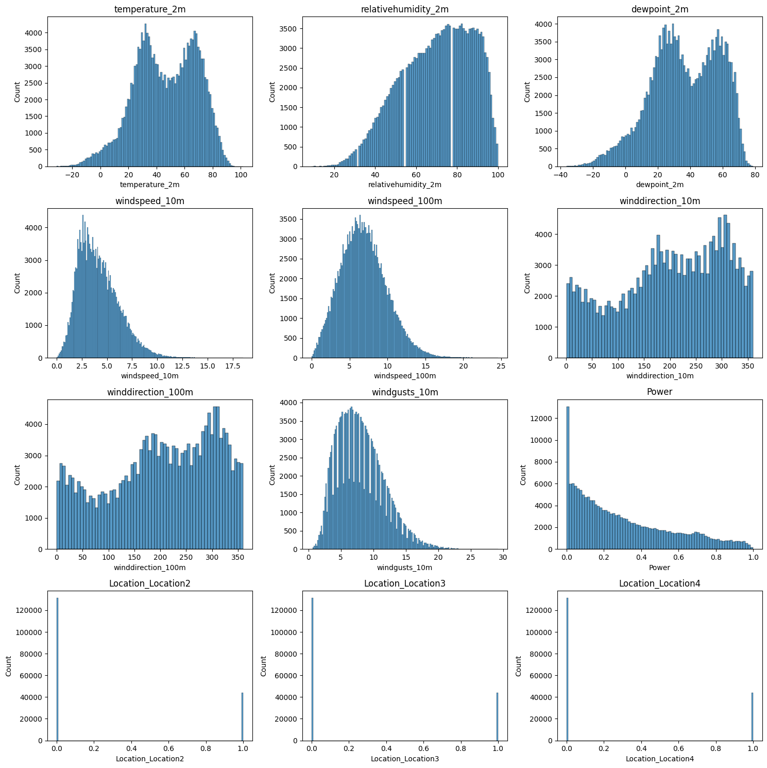
Screenshot of Output:

Slide 8
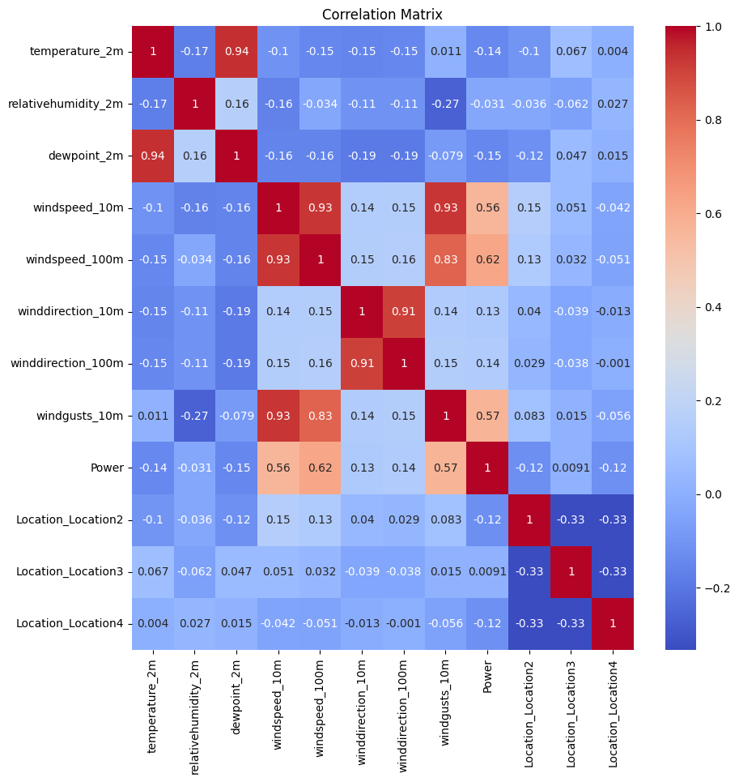
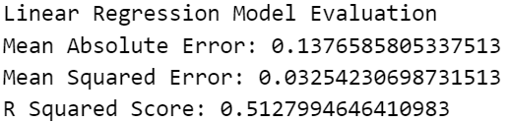
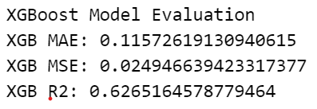
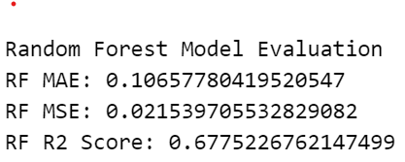
Screenshot of Output:

Slide 9
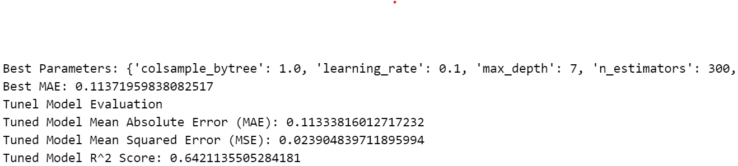
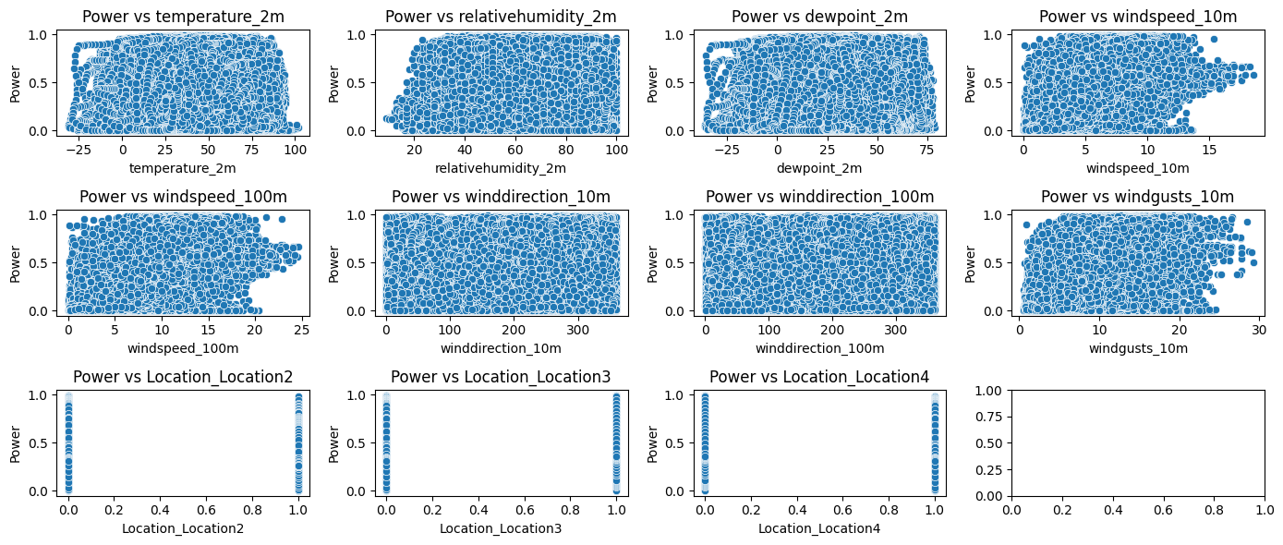
Screenshot of Output:

Slide 10
Conclusion:
Machine learning models like XGBoost can effectively forecast wind power generation.
Proper data preprocessing and feature engineering significantly impact model performance.
The approach provides a scalable solution for smart grid energy planning.

